Slide 1

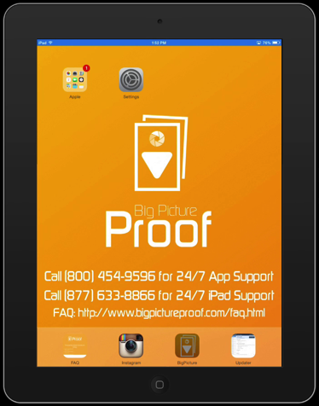
Updater Link Screen
The Updater ICON is for updating the Big Picture Proof App to the newest. Click to update.

Slide 2
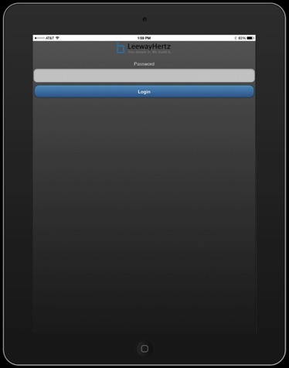
Updater Password Screen
Use the Password 9601 to log into the Updater website.

Slide 3
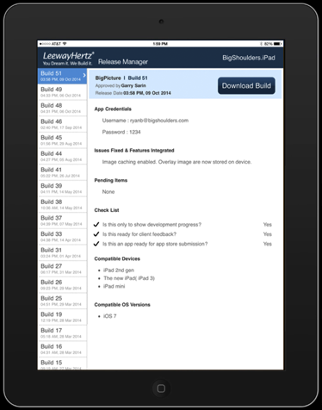
Updater Dowload Screen
On the left hand side make sure you select the newest version of the Big Picture Proof App.
Click DOWNLOAD BUILD to install.

Slide 4
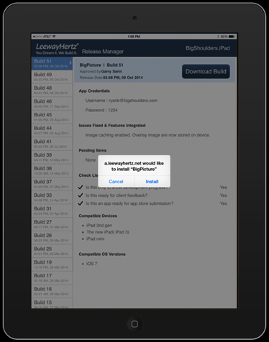
Updater Install Screen
On the left hand side make sure you select the newest version of the Big Picture Proof App.
Click DOWNLOAD BUILD to install.
Click INSTALL to start the process.

Slide 5

App Installing Screen
The new version of the Big Picture Proof app will now install.

